Slide 1
Outbound Order Process
WMS Guide

Slide 2
Table of Contents
Staging Table Summary...........................................................................................................................3
Container Consolidation.........................................................................................................................9
Container Build.........................................................................................................................9
Container Merge ...................................................................................................................16
Shipment Edit……..................................................................................................................................25
Shipping Activities................................................................................................................................30
Parcel......................................................................................................................................30
LTL………………….......................................................................................................................38
Manifest Generation…….......................................................................................................................48
Shipment Completion…........................................................................................................................55
Exception – Cancelled Order……………………..........................................................................................63

Slide 3
Staging Table Summary

Slide 4
Staging Table Summary
The Staging Table Summary view is designed to facilitate the identification and correction of errors in the staging tables. It provides a list of all entry point staging tables for which an error has occurred during the data transfer process from the DMS to the WMS.
The Staging Table Summary should be viewed once a day by a warehouse supervisor or a super-user to make sure that errors are corrected at all times.
This activity is performed with a desktop computer.

Slide 5
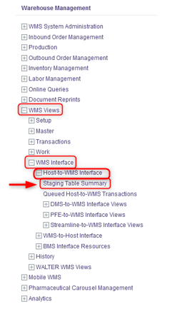
Staging Table Summary
With a desktop computer, select the WMS Views resource.
Under WMS Views, click on WMS Interface.
Under WMS Interface, click on Staging Table Summary.

Slide 6
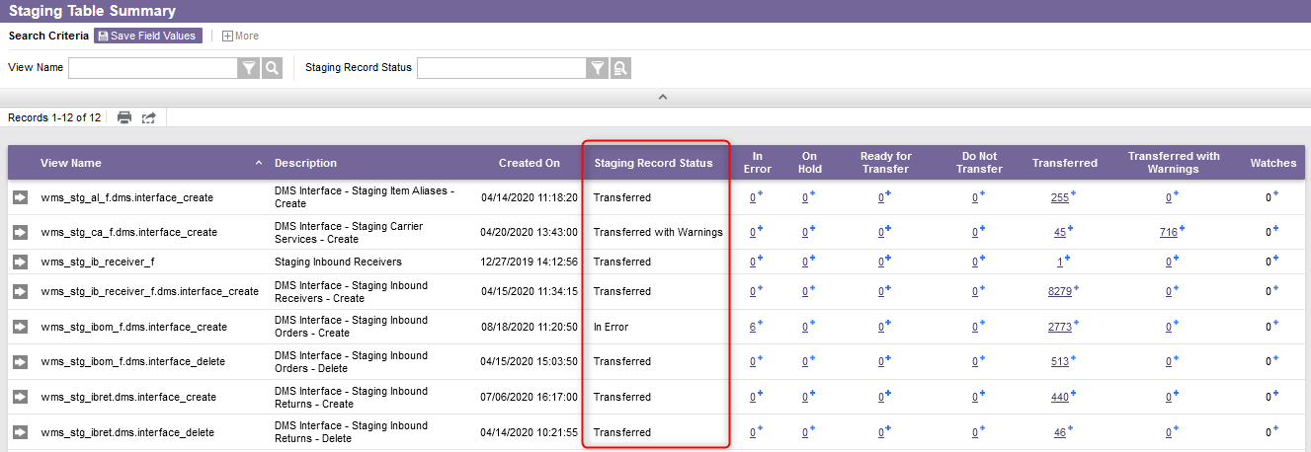
Staging Table Summary
For each table listed, the number of staging messages is displayed by status.

Slide 7
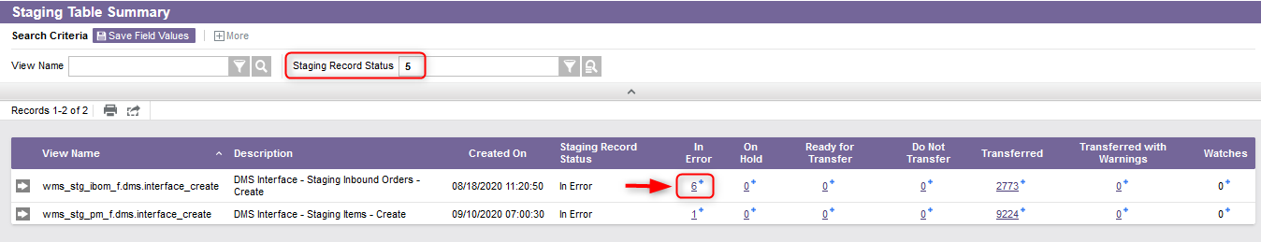
Staging Table Summary
Perform a search to retrieve the records that have an error status.
Click on the value in the In Error Column to preview the records to be corrected and to access the corresponding staging view's search results directly.

Slide 8
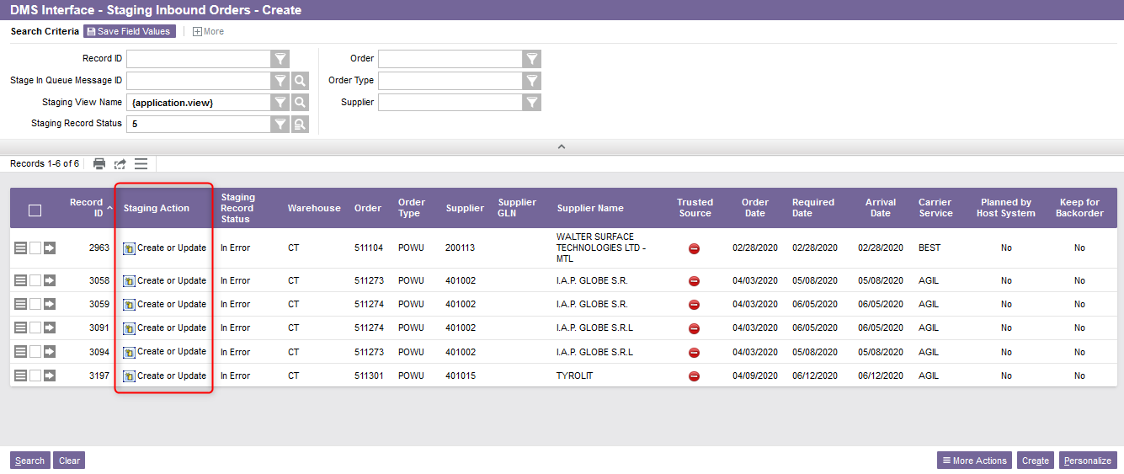
Staging Table Summary
A new DMS Interface window will appear. The actions that need to be taken to correct the error will be displayed in the Staging Action column.

Slide 9
Container Consolidation
Container Build

Slide 10
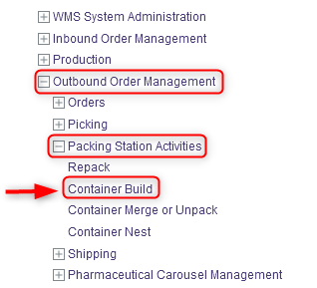
Container Build
Container build is used to add inventory to an existing container or to create new containers that are needed for merging. To do this:
Identify the Containers you want to build and if required the associated tags of inventory to be placed in them (use the Inventory resource to retrieve tags if necessary).
With a desktop computer, select the Outbound Order Management resource.
Under Outbound Order Management, click on Packing Station Activities.
Under Packing Station Activities, click on Container Build.

Slide 11
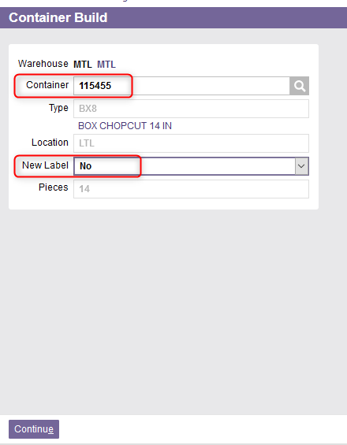
Container Build
Scan or enter your own container number. You can leave the field blank to have the WMS issue a container number automatically.
Set the New Label field to Yes if you would like a new container label to be printed.
  Note: If the container already exists, the Type and Location fields will automatically be displayed.

Slide 12
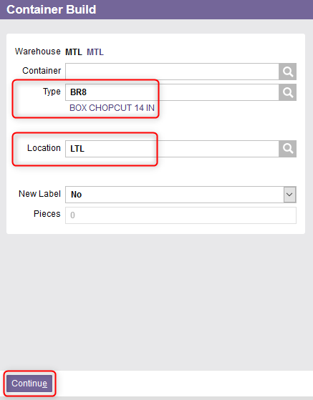
Container Build
If a container is being created that did not already exist:
  Enter the Container Type.
  Enter the Location.
Click Continue.

Slide 13
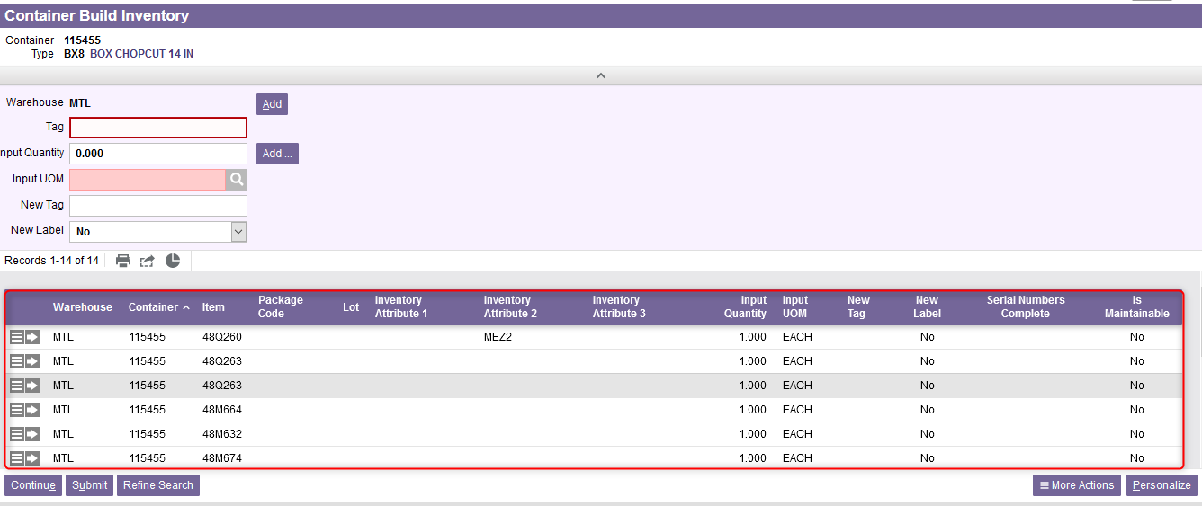
Container Build
The Container Build Inventory window appears which is used to add inventory to the container. If there is any existing inventory within the container, it will be displayed.
If you are creating a container to be used for merging with other containers and no inventory is to be placed directly in the container, you can click Submit and continue at Step #10 to close the resource.

Slide 14
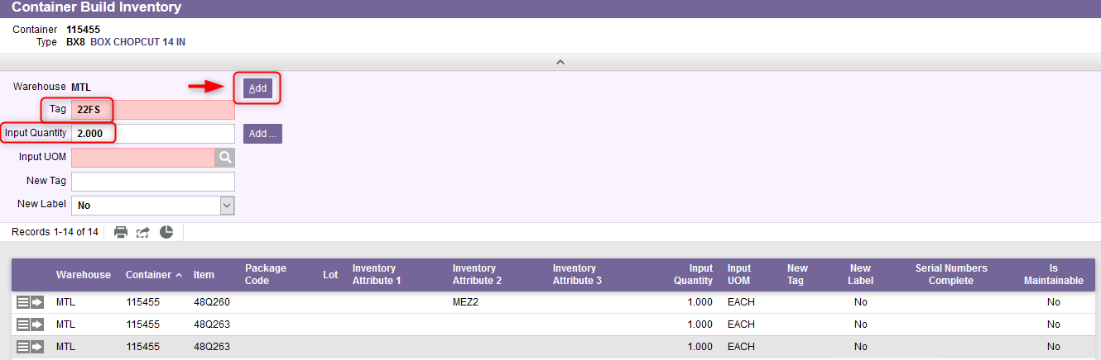
Container Build
If you know the specific Tag IDs that you want to pack into your container:
  Enter the Tag ID in the Tag field
  Enter the quantity to be packed in the Input Quantity field
  Click the first Add button on the screen which will add the tag to the results set.

Slide 15
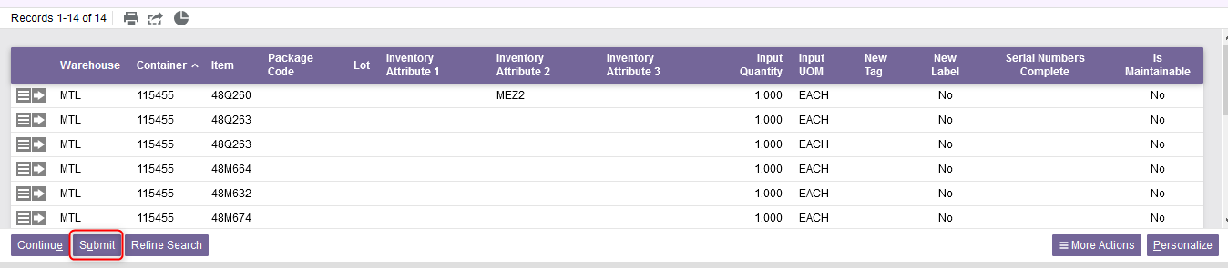
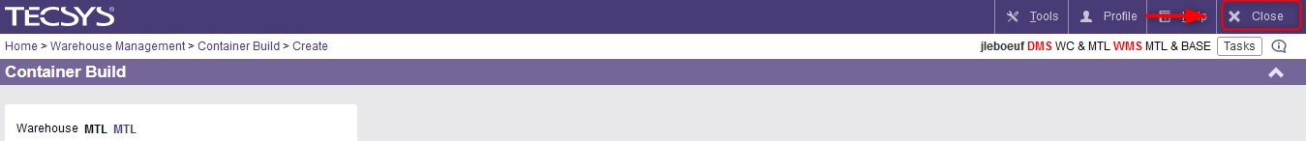
Container Build
Click Submit once you have finished adding the inventory to the container.
Click Close to exit the Container Build resource.

Slide 16
Container Consolidation
Container Merge

Slide 17
Container Merge
Containers that are to be shipped for the same shipment may be merged together.
Container merging is where some or all the contents of one container is combined into another container.
This can be done for LTL Carrier Service Type and Parcels.
Depending on the workstation, this can be done using a desktop or with mobile equipment.

Slide 18
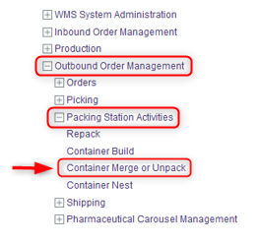
Container Merge
With a desktop computer, select the Outbound Order Management resource.
Under Outbound Order Management, click on Packing Station Activities.
Under Packing Station Activities, click on Container Merge or Unpack.

Slide 19
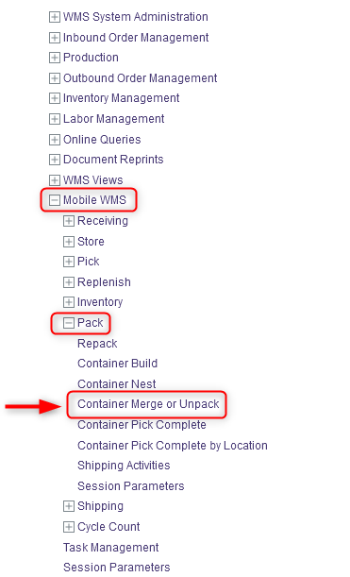
Container Merge
You also have the option to perform the Container Merge using a mobile equipment. If you are using a mobile equipment:
Select the Pack resource.
Under Pack, click on Container Merge or Unpack.
A new Container Merge or Unpack window will appear. The procedural steps and system behavior are the same for both the desktop and mobile equipment processes. Follow the same steps as explained starting from the next slide.

Slide 20
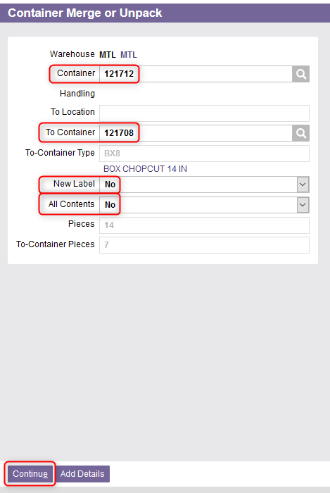
Container Merge
Enter the Container ID that is being merged into the second container in the Container field (your from container)
Enter the Container ID of the one receiving the inventory in the To Container field
  Note: If necessary, you can review available containers for shipment the Shipping Activities resource.

Slide 21
Container Merge
If you would like a new container label to be printed at the end of the merge, set the New Label field to Yes.
Update the All Contents field as required:
  If you are emptying the from container and transferring the entire contents to the new container set the All Contents field to Yes.
  If you are only transferring some of the contents of your from container to the new container set the All Contents field to No.
Click Continue.

Slide 22
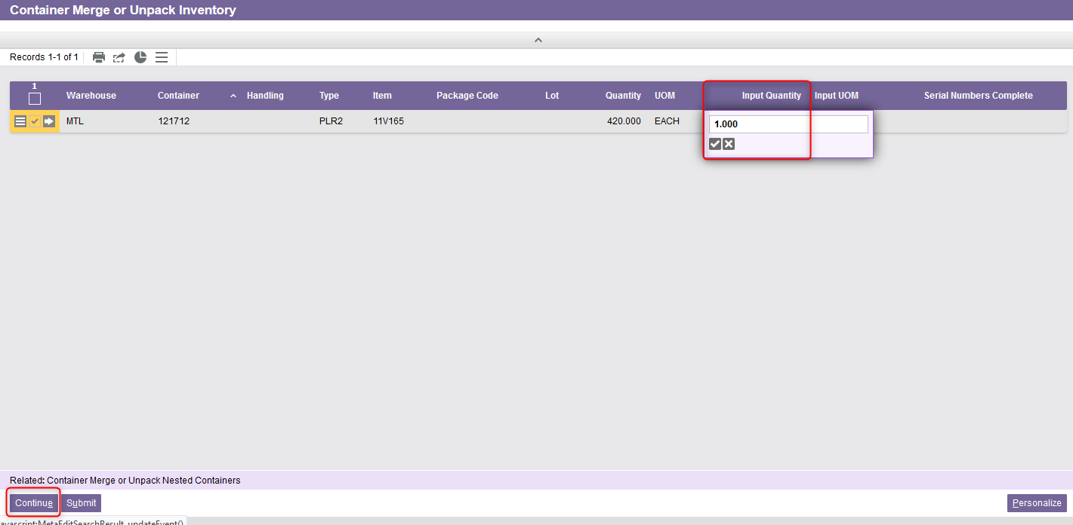
Container Merge
The Container Merge or Unpack Inventory screen is displayed showing details of the container. If you are not transferring All Contents, update the Input Quantity field to represent the amount of inventory you are moving to the new container.
Click Continue.

Slide 23
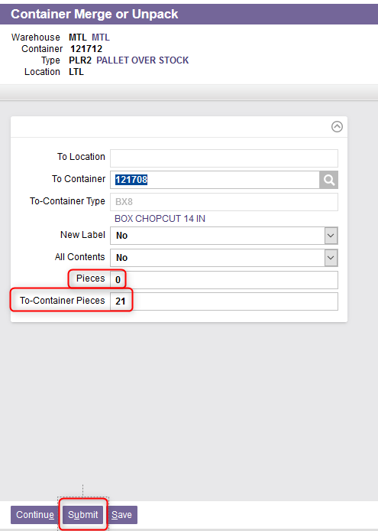
Container Merge
The Container Merge or Unpack screen is redisplayed. The Pieces field will have been updated to reflect the amount of inventory remaining in the from container, and the To-Container Pieces field will have been updated to reflect the total amount of inventory that will now exist in the to container
Manually change the number of pieces if desired.
Click Submit once you have finished merging the inventory.

Slide 24
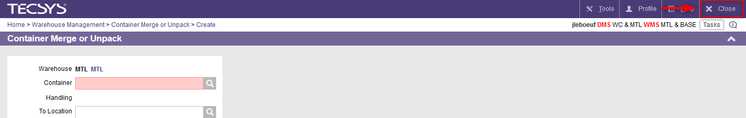
Container Merge
Click Close to exit the Container Merge resource.

Slide 25
Shipment Edit

Slide 26
Shipment Edit
Optionally, information concerning a shipment may be examined or modified through the Shipment Edit resource, which is available on a desktop computer.
This allows the user to modify some of the shipping information for outbound orders. For example, this may be the carrier service, the pick destination, the freight payment type, the ship to name and ship to address information.
Unless modified, the information displayed will be printed out on the shipping labels.
The Shipment Edit activity can be done before or after the consolidation of the containers.

Slide 27
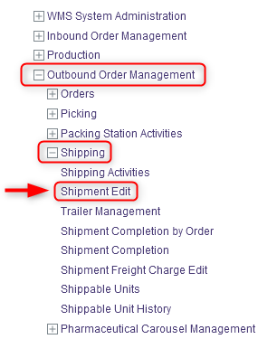
Shipment Edit
With a desktop computer, select the Outbound Order Management resource.
Under Outbound Order Management, click on Shipping.
Under Shipping, click on Shipment Edit.

Slide 28
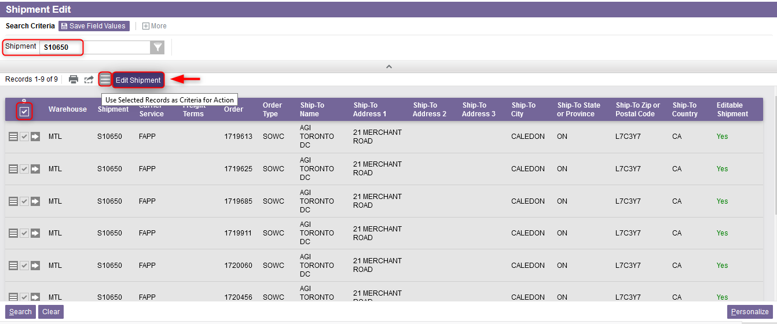
Shipment Edit
From the new window, perform a search to retrieve the appropriate shipment.
Select the records you wish to edit
Select the Use Record as Criteria for Action button and click on the Edit Shipment action.

Slide 29
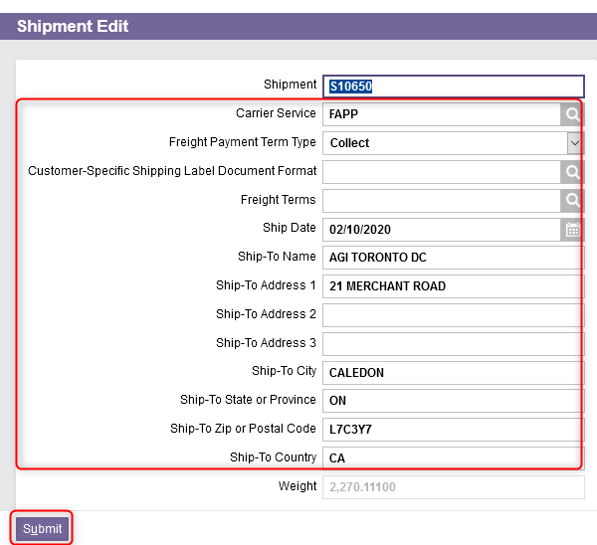
Shipment Edit
A new window will appear from which you can modify the following fields:
  Carrier Service
  Shipping Label Format
  Freight Terms
  Ship-To Name,
  Address 1 to 3,
  City, State or Province, Zip or Postal Code and Country
Select the Submit action. This will update the changes made to the shipping data.

Slide 30
Shipping Activities
Parcel

Slide 31
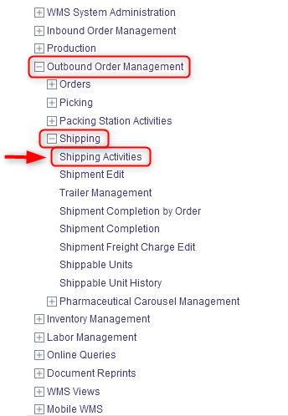
Shipping Activities – Parcel
With a desktop computer, select the Outbound Order Management resource.
Under Outbound Order Management, click on Shipping.
Under Shipping, click on Shipping Activities.

Slide 32
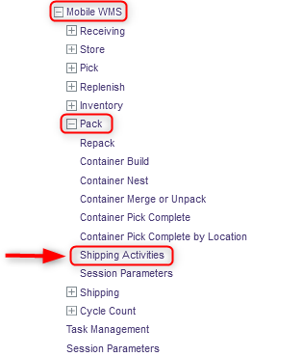
Shipping Activities – Parcel
You also have the option to perform the Shipping activities using a mobile equipment. If you are using a mobile equipment:
Select the Pack resource.
Under Pack, click on Shipping Activities.
A Shipping Activities window will appear. The procedural steps and system behaviour are the same for both the desktop and mobile equipment processes. Follow the same steps as explained starting from the next slide.

Slide 33
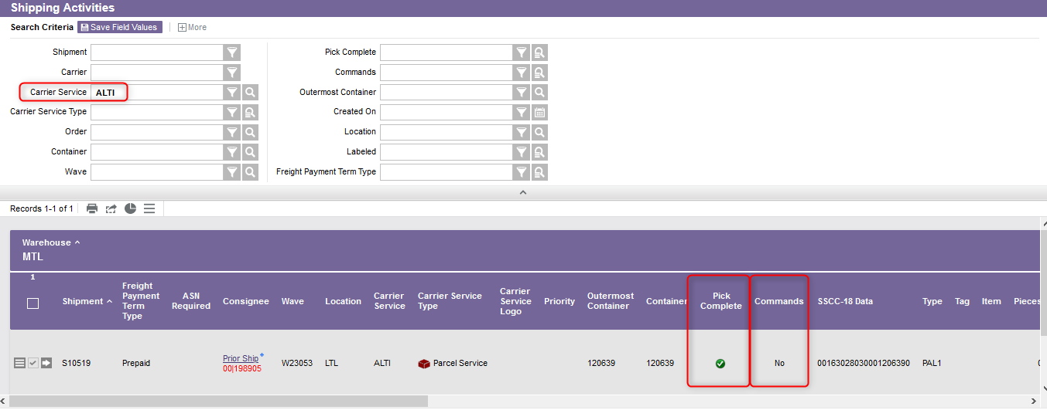
Shipping Activities – Parcel
Enter your shipment details in the search criteria and Click Search.
Make sure the flag is green in the Pick Complete column and the Commands column is No (meaning there is no command queue in the WMS).

Slide 34
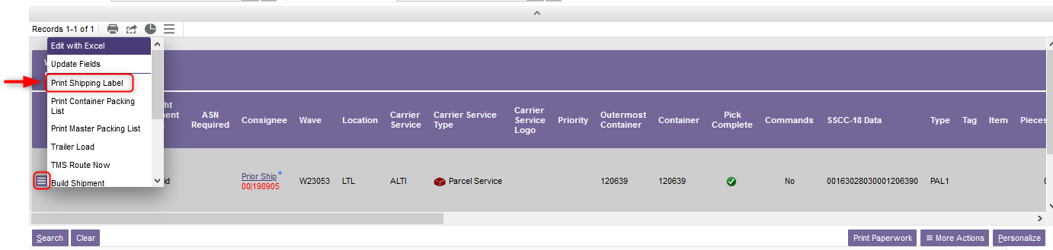
Shipping Activities – Parcel
Select all the records you wish to process.
Select the Use Record as Criteria for Action button and click on the Print Shipping Label action.
To print a shipping label for an individual container, click on the row level action icon to the left of the displayed record.
To print multiple labels for the same shipment, check the box to the left of each record before clicking on the grid level action icon which is displayed in the grid level toolbar immediately above the search results.

Slide 35
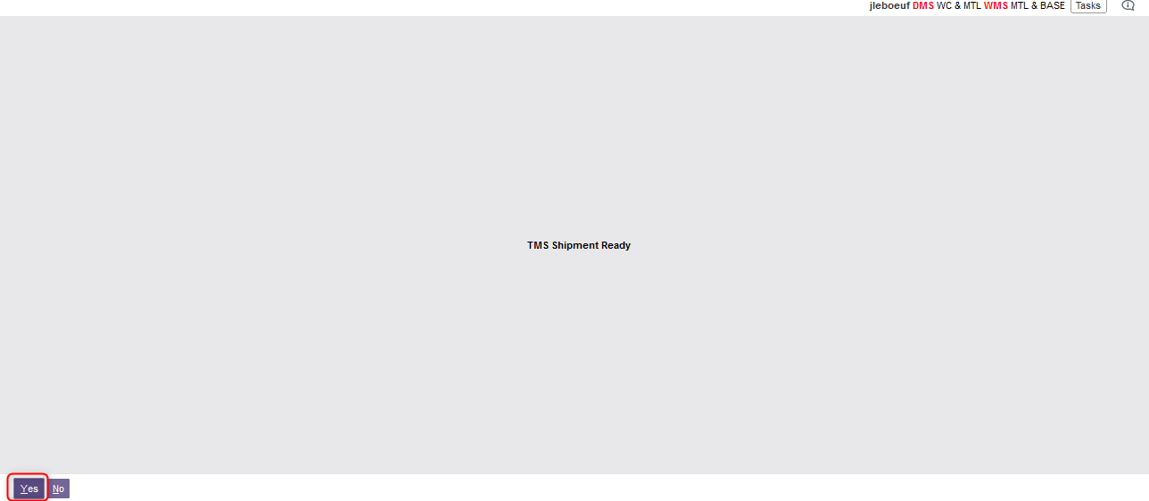
Shipping Activities – Parcel
A message stating that the TMS shipment is ready will appear. Select Yes.

Slide 36
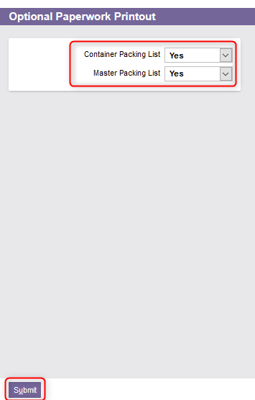
Shipping Activities – Parcel
The Optional Paperwork Printout window will appear. You can also print a Container Packing List for the Shippable Unit by selecting Yes.
  Note: If this is the last container for a shipment you will also have the option to print a Master Packing List.
Click Submit.

Slide 37
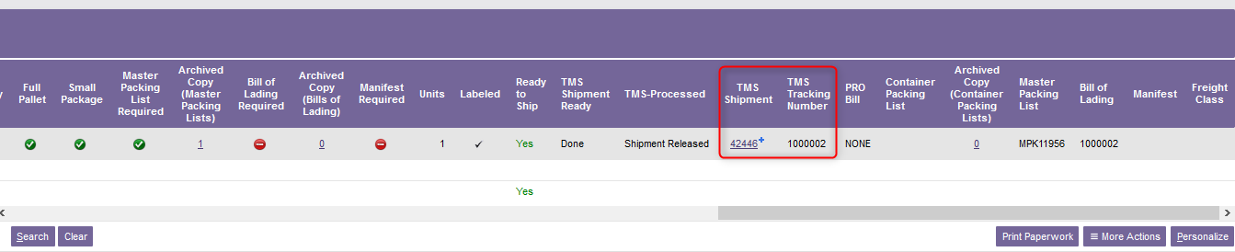
Shipping Activities – Parcel
The Shipping Activities resource will be redisplayed and refreshed based on the print options you selected. The TMS Shipment and the TMS tracking number are generated:
Click Close to exit the Shipping Activity resource.

Slide 38
Shipping Activities
LTL

Slide 39
Shipping Activities – LTL
As the same way as for parcel:
With a desktop computer, select the Outbound Order Management resource.
Under Outbound Order Management, click on Shipping.
Under Shipping, click on Shipping Activities.

Slide 40
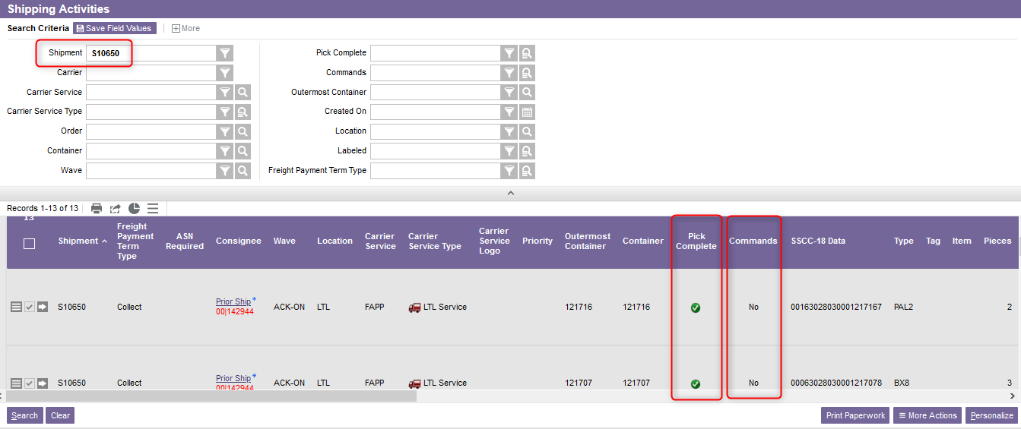
Shipping Activities – LTL
Enter your shipment ID in the search criteria and Click Search.
Make sure the flag is green in the Pick Complete column and the Commands column is No (meaning there is no command queue in the WMS).

Slide 41
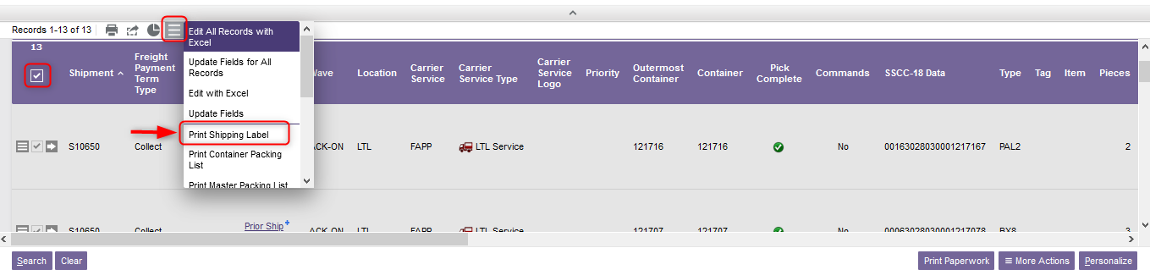
Shipping Activities – LTL
Select all the records you wish to process.
Select the Use Record as Criteria for Action button and click on the Print Shipping Label action.

Slide 42
Shipping Activities – LTL
From the new window that appears, optionally indicate whether you want to print the Container Packing List and the Master Packing List by selecting Yes.
Click Submit.

Slide 43
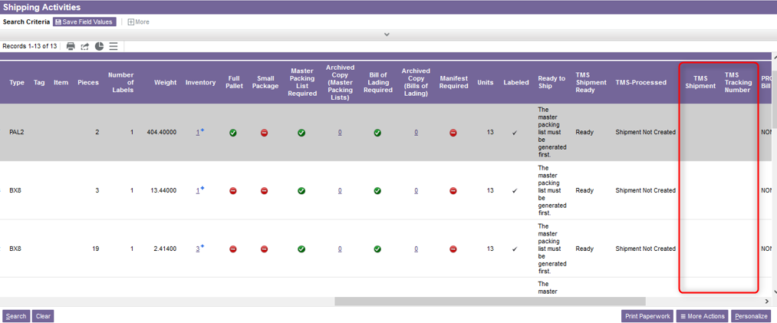
Shipping Activities – LTL
Additional note – At this step, the Shipping Activities resource will be redisplayed. You may notice that the TMS Shipment and the TMS tracking number have still not been created.

Slide 44
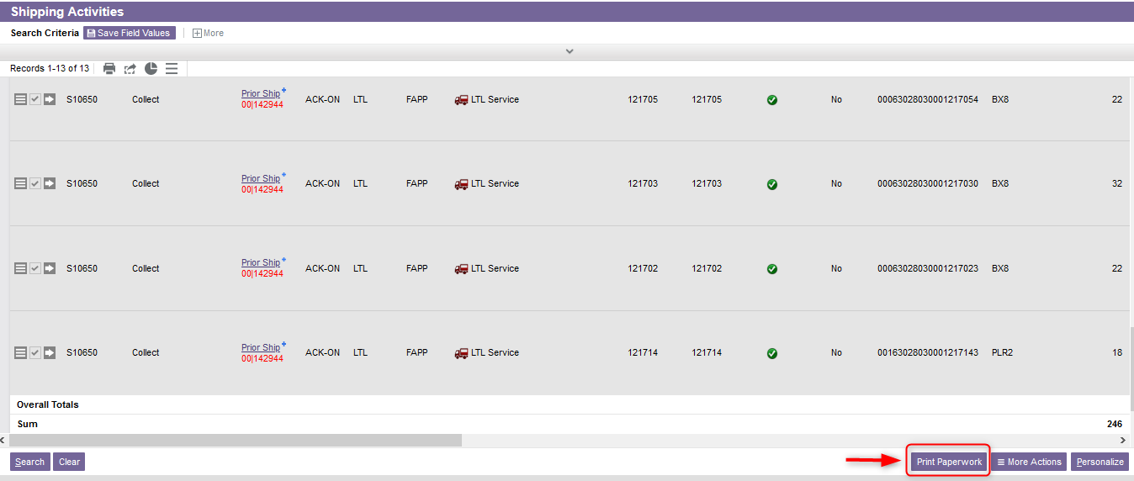
Shipping Activities – LTL
To generate a TMS Shipment and a TMS tracking number, click on Print Paperwork at the bottom left of your screen.

Slide 45
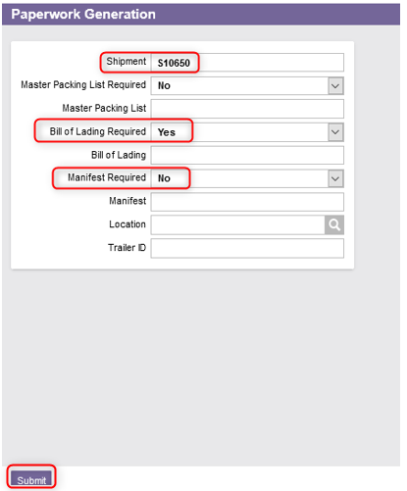
Shipping Activities – LTL
From the new Paperwork Generation window, enter the Shipment ID.
Select Yes to print the Bill of Lading and No for the Manifest.
Click Submit.

Slide 46
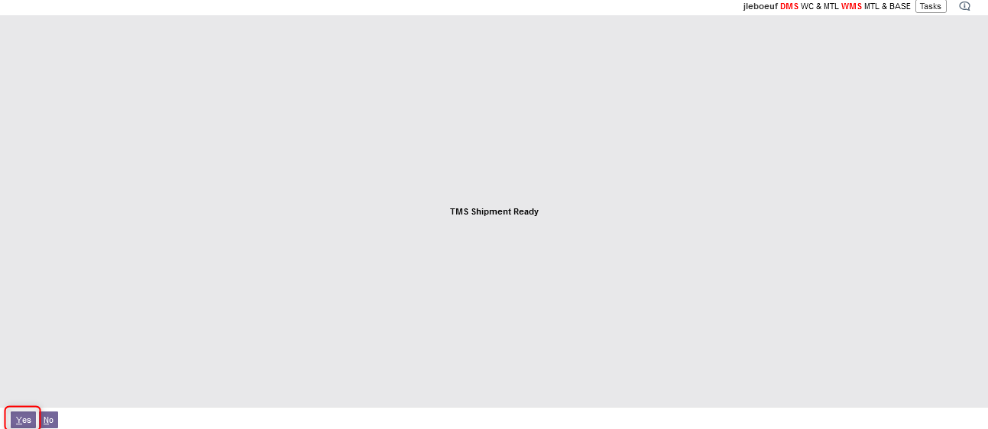
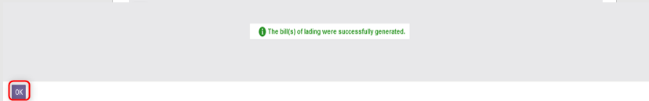
Shipping Activities – LTL
A message stating that the TMS shipment is ready will appear. Select Yes.
A message will be displayed informing you that the appropriate documents have been generated. Click OK.
Note: If there is any hazardous material among the products being shipped, the appropriate documentation will also be printed at this time.

Slide 47
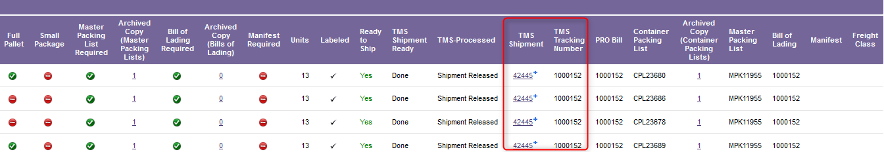
Shipping Activities – LTL
The Shipping Activities resource will be displayed again showing the TMS shipment as well as the TMS Tracking number.
Click Close to exit the Shipping Activity resource.

Slide 48
Manifest Generation

Slide 49
Manifest Generation
The generation of the manifest is done using the Transport Management system.
The Carrier Closeout view is used to initiate the process that closes shipment transactions for the selected carrier.
Once closed, the manifest will be printed automatically, and shipments will be ready for carrier pickup and delivery.
This activity should be done on a daily basis.

Slide 50
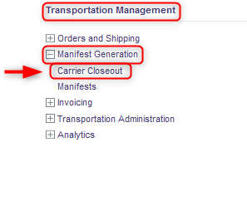
Manifest Generation
To close shipments for a selected carrier and generate a manifest, follow these steps:
With a desktop computer, select the Transport Management Module.
Select the Manifest Generation resource.
Under Manifest Generation, click on Carrier Closeout.

Slide 51
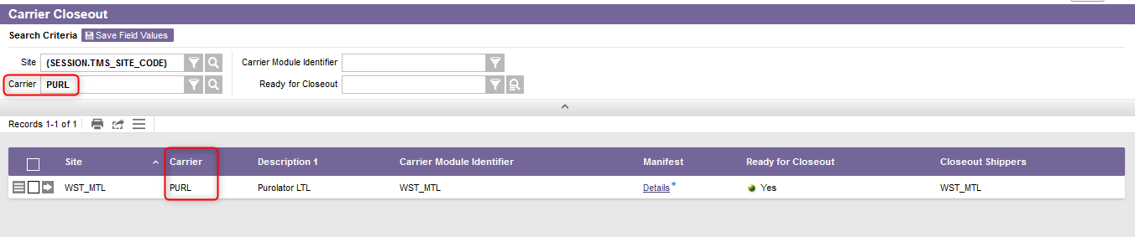
Manifest Generation
Perform a search by carrier that will retrieve the shipments you wish to close.

Slide 52
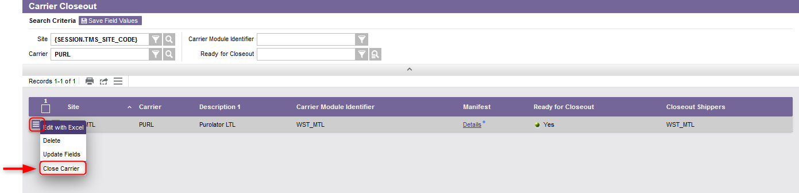
Manifest Generation
Select the Use Record as Criteria for Action button and click on Close Carrier action.
Once closed, the manifest will be automatically generated and printed.
Click Close to exit the Carrier Closeout resource.

Slide 53
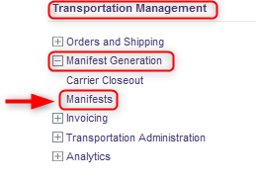
Manifest Generation
Additionnal note – The Manifests resource allows you to preview the list of manifests that have been generated, to validate the transactions performed and to re-close out and/or reprint the documents if desired. To do this:
With a desktop computer, select the Transport Management Module.
Select the Manifest Generation resource.
Under Manifest Generation, click on Manifests.

Slide 54
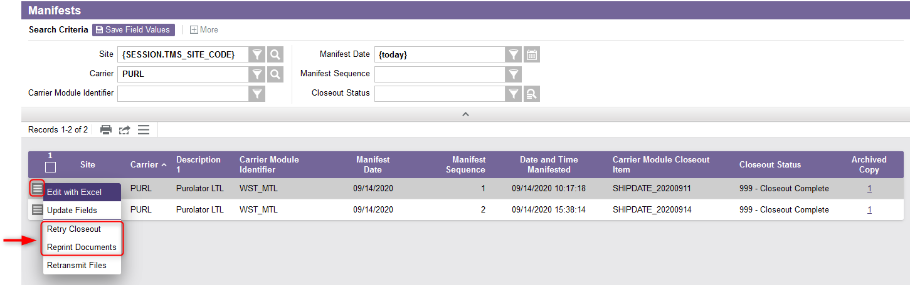
Manifest Generation
Additionnal note (continued)
The list of all manifests will be displayed. Perform a search to retrieve a specific record if desired.
Select the Use Record as Criteria for Action button and click on the desired action (Retry Closeout or Reprint Documents).

Slide 55
Shipment Completion

Slide 56
Shipment Completion
The final step in shipping product out the door is to perform a Shipment Completion.
This is an indication to the WMS that the shipments have left the warehouse completely.
This activity is performed with a desktop computer or a mobile equipment.

Slide 57
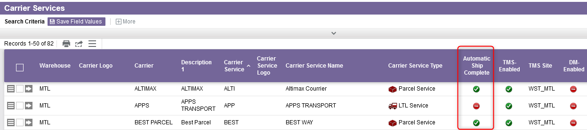
Shipment Completion
Depending on the carrier services used, the Shipment Completion step may be done automatically and is therefore optional. Usually, the shipment completion for parcel shipments is done automatically unlike LTL shipments.
If desired, you can verify whether the shipment completion is done automatically or not using the Carrier Services resource.

Slide 58
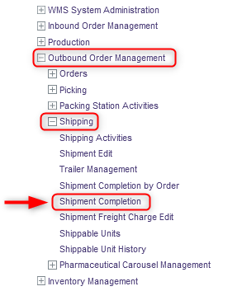
Shipment Completion
If you need to do a shipment completion, do this:
With a desktop computer, select the Outbound Order Management resource.
Under Outbound Order Management, click on Shipping.
Under Shipping, click on Shipment Completion.

Slide 59
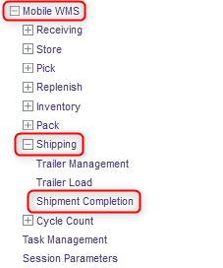
Shipment Completion
You also have the option to perform the Shipment Completion activity using a mobile equipment. If you are using a mobile equipment:
Select the Shipping resource
Under Shipping, click on Shipment Completion.
A new Shipment Completion window will appear. The procedural steps and system behaviour are the same for both the desktop and mobile equipment processes. Follow the same steps as explained starting from the next slide.

Slide 60
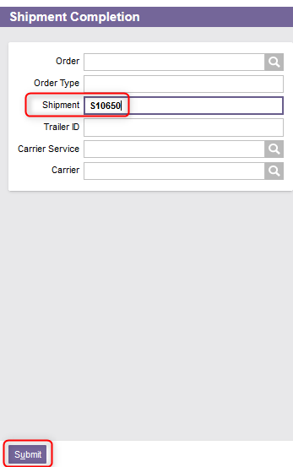
Shipment Completion
From the new window, enter the Shipment ID.
Click Submit.

Slide 61
Shipment Completion
The system will process the record and delete the inventory that has been shipped from the WMS. A confirmation message will appear:
The Shipment Completion view’s Search page is then redisplayed. Click Close to exit the Shipment Completion resource.

Slide 62
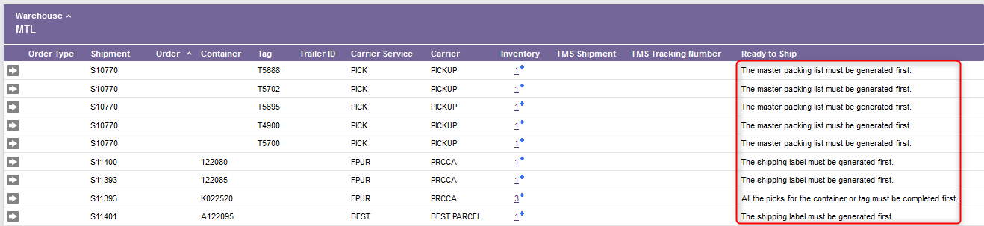
Shipment Completion
Additionnal note – Maintenance of shipments should be done once a day. By searching from the Shipment Completion window, you will find all the records to be processed.
Shipments with the Ready to Ship column set to Yes should be processed right away.
Shipments for which action is to be taken should then be processed one at a time if necessary.

Slide 63
Exception – Cancelled Order

Slide 64
Exception – Cancelled Order
In the event that a sale order is cancelled, do this:
Access the Outbound Order Management resource.
Under Outbound Order Management, click on Shipping.
Under Shipping, click on Shipping Activities.

Slide 65
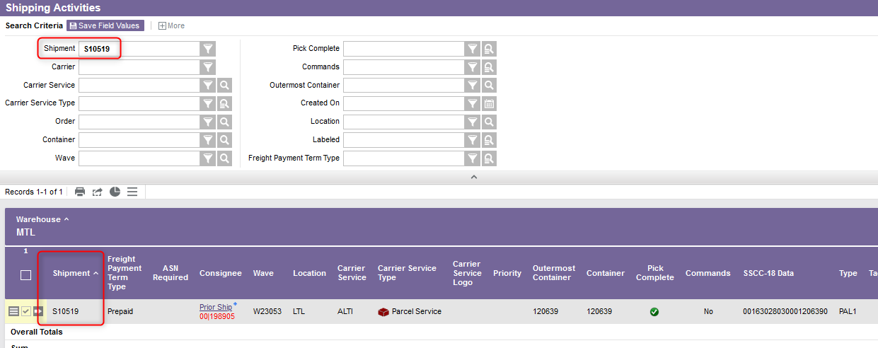
Exception – Cancelled Order
Retrieve the shipment associated with the sale order you wish to cancel.

Slide 66
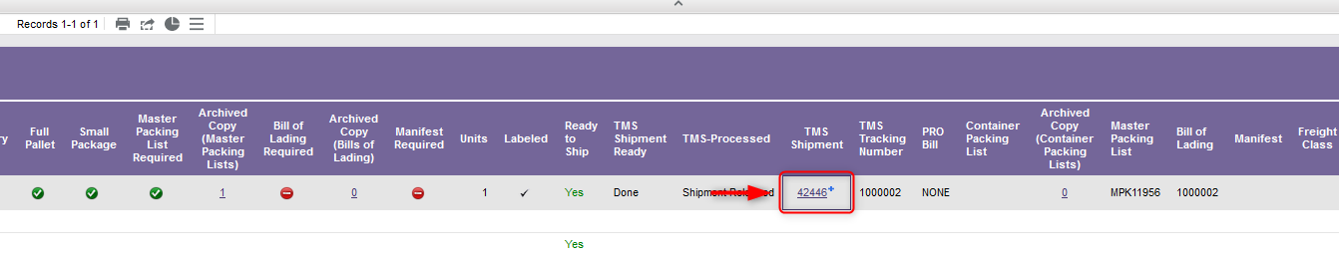
Exception – Cancelled Order
Click on the value in the TMS Shipment column.

Slide 67
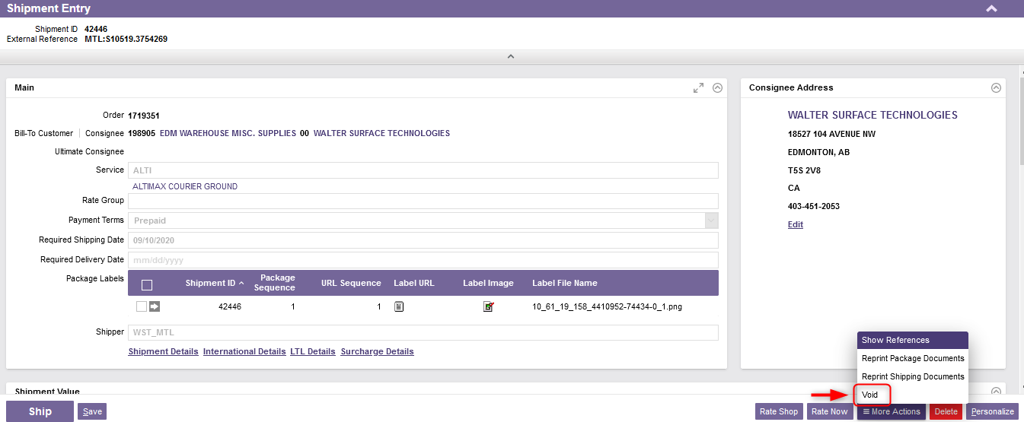
Exception – Cancelled Order
From the new window, at the bottom right of your screen, click on More Action, then on the Void action.
A confirmation message will appear.

Slide 68
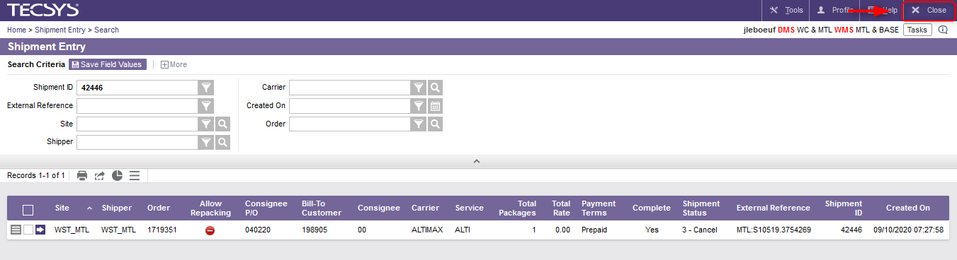
Exception – Cancelled Order
Click close to exist the Shipment Entry resource.

Slide 69
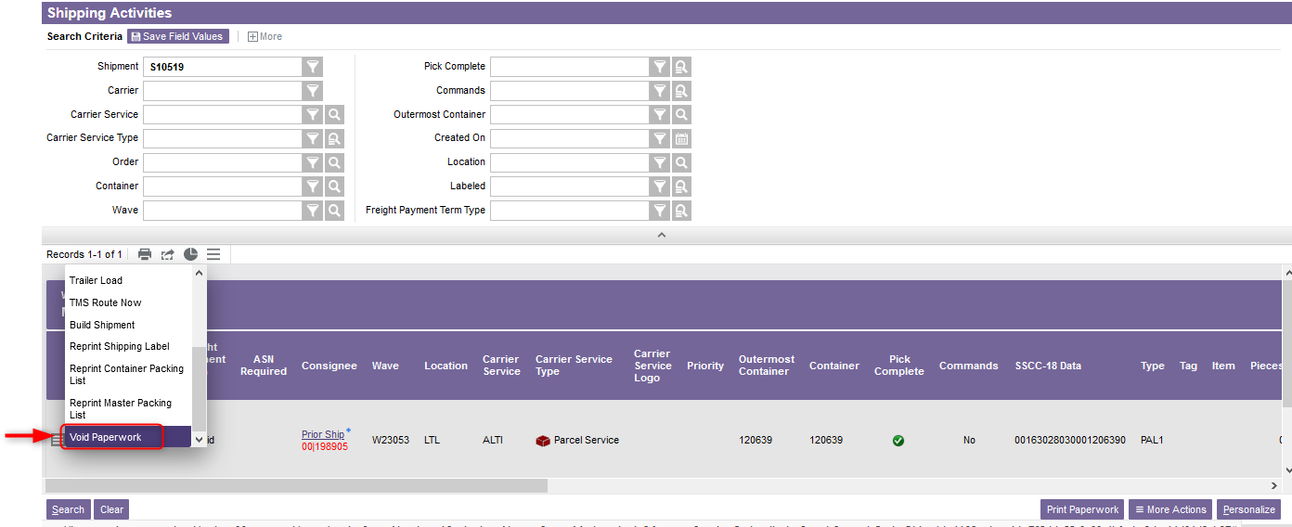
Exception – Cancelled Order
Return to the Shipping Activities resource and retrieve the appropriate shipment.
Select the Use Record as Criteria for Action button and click on the Void Paperwork action.

Slide 70


Exception – Cancelled Order
From the new window, select the Void action for each paperwork.
Click Submit.
You will be redirected to the Shipping Activities resource. Click Close to exit the resource.

Slide 71
Exception – Cancelled Order
You then have to unpack the container. Container unpacking is where some or all the contents of a container are removed (unpacked) to a specified location. To do this:
Access the Outbound Order Management resource.
Under Outbound Order Management, click on Packing Station Activities.
Under Packing Station Activities, click on Container Merge or Unpack.

Slide 72

Exception – Cancelled Order
Enter the Container ID that will be unpacked in the Container field.
Enter the location where the unpacked inventory will be placed in the To Location field.
Update the All Contents field as required. If you are unpacking the container and transferring the entire contents to the new location set the All Contents field to Yes. Otherwise, select No in the event that only a partial quantity needs to be removed from the outbound order.
Click Continue.

Slide 73

Exception – Cancelled Order
The Container Merge or Unpack Inventory screen is displayed. The Input Quantity field represents the amount of inventory you are unpacking from the container. If you selected All Contents to be unpacked the Input Quantity field is for display purposes only, it is defaulted to the quantity currently in the from container and cannot be changed. Otherwise, manually change the Input Quantity of the item you wish to remove from the outbound order.
Click Continue.

Slide 74

Exception – Cancelled Order
The Container Merge or Unpack screen is redisplayed. Note that the Pieces field will have been updated to reflect the amount of inventory remaining in the from container.
Click Submit once you have finished unpacking the container.
Note: If unpacked inventory was previously associated to an outbound order, at this stage, it will remain assigned to the order.
Click Close to exit the Container Merge or Unpack resource.

Slide 75

Exception – Cancelled Order
You then have to move the item(s) to the right location in the warehouse. To do this:
With a mobile device, select the Inventory resource.
Under the Inventory resource, click on Move.

Slide 76

Exception – Cancelled Order
In the Move window, enter the Tag to be moved.
Usually, the Requested Location is left blank. The location of the product will be thus determined according to the storage rules previously defined. If desired, specify the Requested Location to force the product to be stored in a specific location.
Click Continue.

Slide 77

Exception – Cancelled Order
A message will appear asking you to confirm the quantity to be dissociated from the order. Select Yes to confirm.

Slide 78

Exception – Cancelled Order
In the Store Tag Command window, confirm the drop-off point.
Then, click Continue.
Click Close to exit the resource.

Slide 79

Exception – Cancelled Order
Finally, you may need to delete the outbound order from the WMS. This step is required if all items of the order have been removed; otherwise, it is not necessary to delete the order.
To do this:
With a desktop computer, select the Outbound Order Management resource.
Under Outbound Order Management, click on Orders.
Under Orders, click on Outbound Order Entry.

Slide 80

Exception – Cancelled Order
Perform a search to retrieve the shipment associated to the order you wish to cancel.
Select the Use Record as Criteria for Action button and click on the Cancel Order action.

Slide 81

Exception – Cancelled Order
A message will appear. Select OK to confirm.
A confirmation message will be displayed confirming that the order has been cancelled from the WMS.
Click close to exit the Outbound Orders resource.

